Slide 1
Graphical User Interface
Form Based Programming in C Sharp

Slide 2
Topics
Windows Form Applications
Form Controls
Labels
Text Box
Command Button
Example : Simple Form Based Calculator
Mini Project 6
Library Management System
Sample form & code

Slide 3
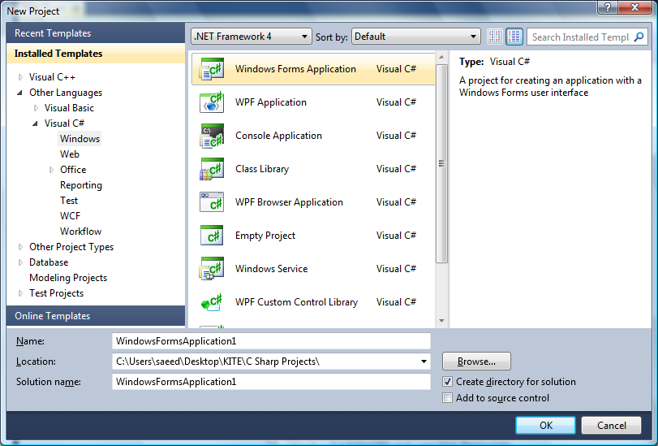

Slide 4
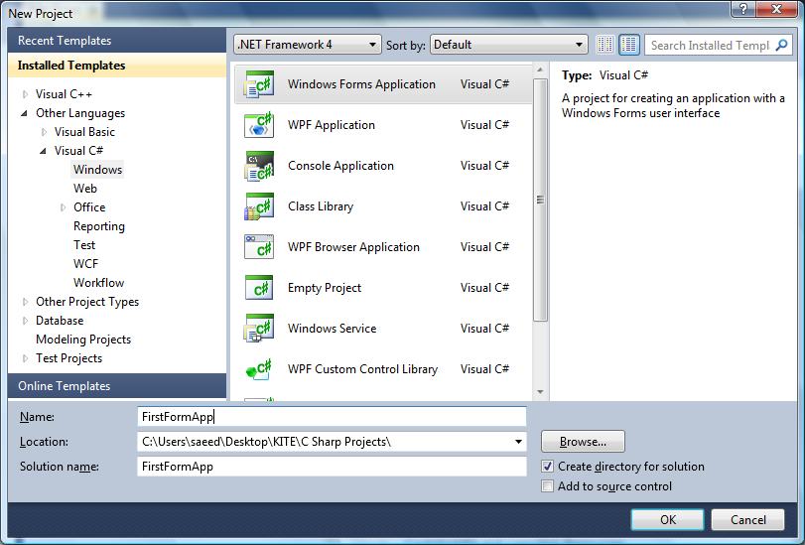

Slide 5
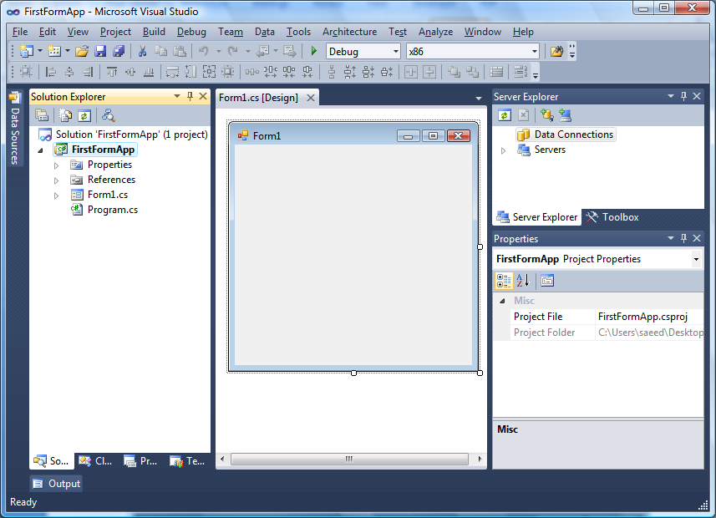

Slide 6
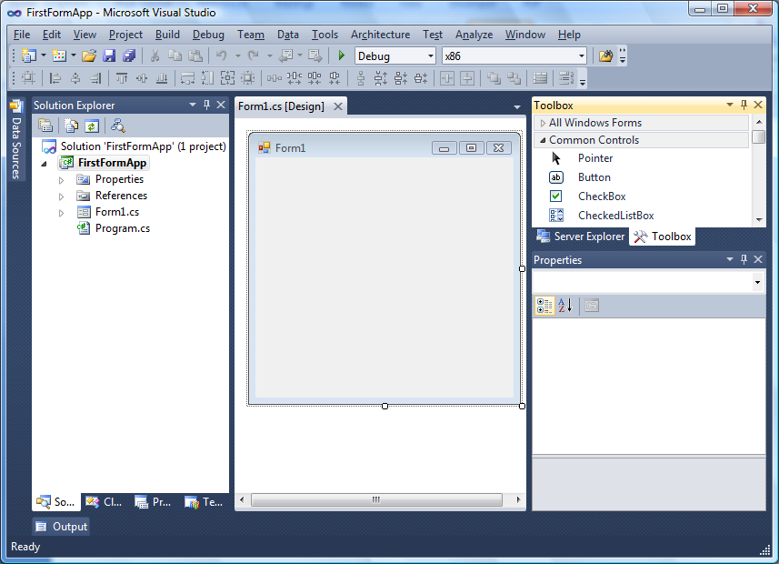

Slide 7
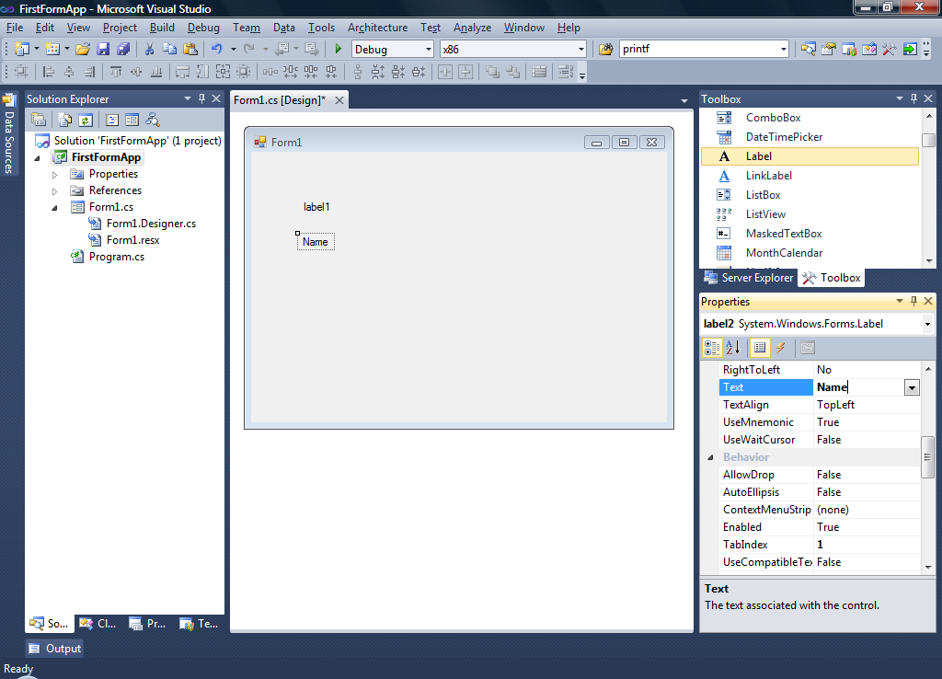

Slide 8
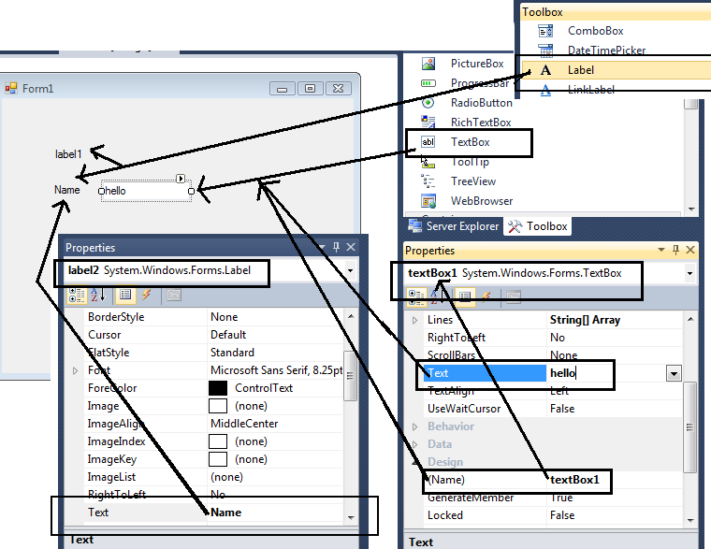
Label + TextBox

Slide 9
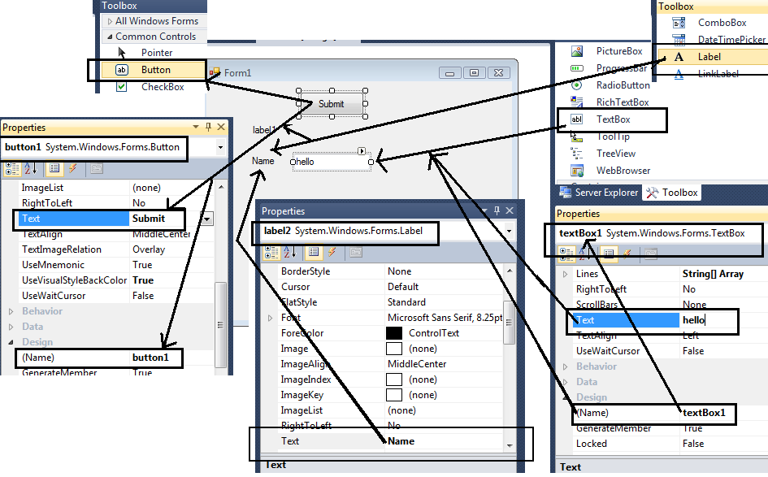

Slide 10
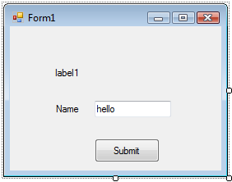

Slide 11
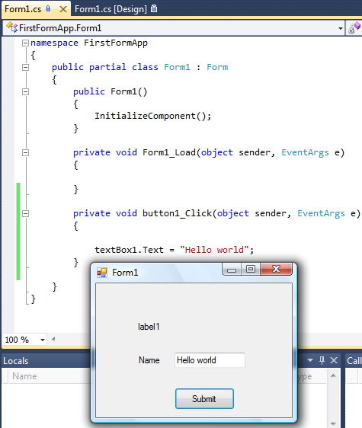

Slide 12
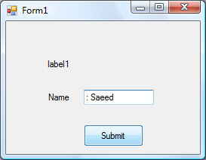
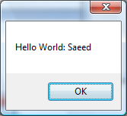
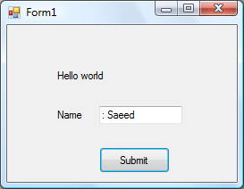


Slide 13
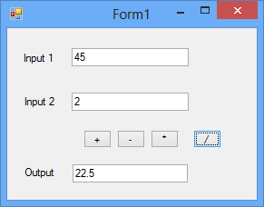
Example : Simple Form Based Calculator

Slide 14
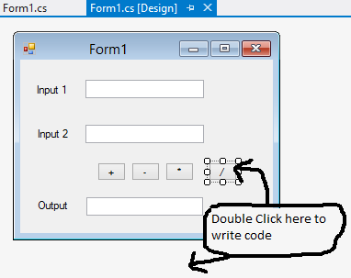
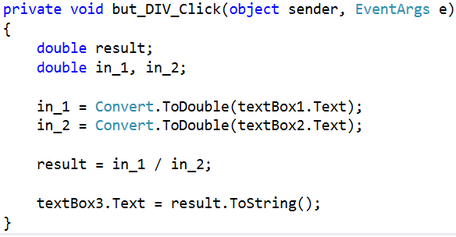
Example : Simple Form Based Calculator

Slide 15
Mini Project 6
Convert Library Management System into Windows Form Application
Add New Book
Issue Book to Teacher/Student
Return Books ( add required controls in given form)
Save and Restore all data from Binary Files
Bonus Points
You may also add (Grid Control to show all books in one table)
Add New Form for each task and call appropriate form when needed
Help : Initial Form based help can be get from link provided by Sir Ali Raja
http://www.homeandlearn.co.uk/csharp/csharp.html

Slide 16
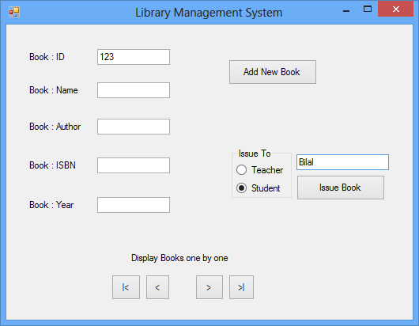
LMS Form

Slide 17
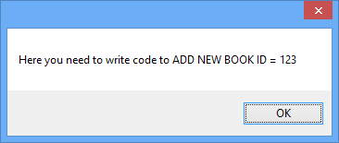
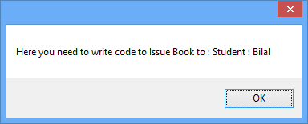
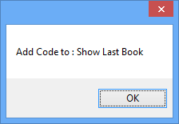
Message Box

Slide 18
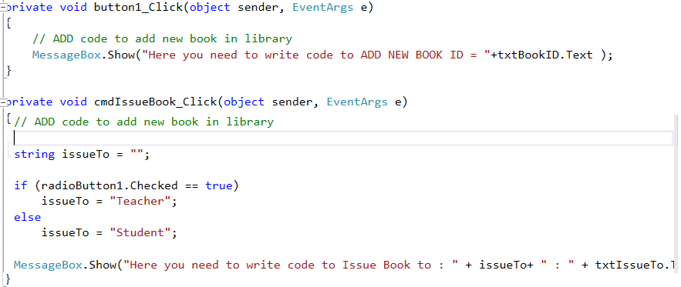
Initial Code – New/Issue Book
To write code behind Control Buttons you just need to double click on button Visual Studio will write Function ( Initial line , { ,} ) automatically …

Slide 19
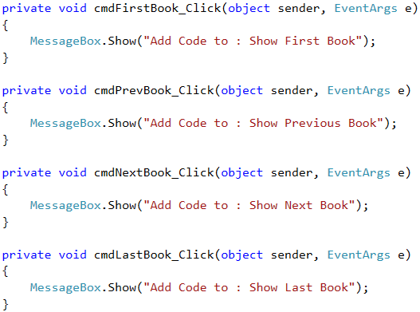
Initial Code – Show books

